Slide 1
Welcome to our maths parent workshop. This evening we will…
Find out what children learn in Maths in Foundation Stage and Key Stage 1.
Discuss how we teach Maths and why.
Look at some resources and models we use.
Support you with ideas to help at home.

Slide 2
Our aims for your children
Have a positive attitude towards maths.
Recall and apply knowledge rapidly and accurately.
Reason mathematically by justifying, making links to known facts, or providing proof using mathematical language.
Be increasingly confident with mental calculations, developing and sharing their own flexible methods.
Be resilient when something is challenging
We are all mathematicians!

Slide 3
Mastery in Mathematics
Puts numbers first: confidence with numbers is the first step to competency in the curriculum as a whole.
Puts depth before breadth: we reinforce knowledge again and again.
Encourages collaboration: children progress as a group, supporting each other as they learn.
Focuses on fluency, reasoning and problem solving: gives children the skills they need to become competent mathematicians.
Notes:
With this in mind we encourage our children to develop a greater depth of understanding rather than just working on the next topic. It is important for children to really grasp how to perform a procedure in many different ways and contexts rather than just working with greater numbers. We want to make sure the foundations are really secure.

Slide 4
Our aim for your children - Mastery in Mathematics
So before exploring numbers to 100, consider the following with numbers to 10:
Notes:
What do you notice about

Slide 5
Early Learning Goals – Foundation Stage
Number
Have a deep understanding of numbers to 10, including the composition of each number.
Subitise (recognise quantities without counting) up to 5.
Automatically recall (without reference to rhymes, counting or other aids) number bonds up to 5 (including subtraction facts) and some number bonds to 10, including double facts.

Slide 6
Early Learning Goals – Foundation Stage
Numerical Patterns
Verbally count beyond 20, recognising the pattern of the counting system.
Compare quantities up to 10 in different contexts, recognising when one quantity is greater than, less than or the same as the other quantity`.
Explore and represent patterns within numbers up to 10, including evens and odds, double facts and how quantities can be distributed equally

Slide 7
The National Curriculum – from Year 1 onwards
Year 1
Number - Number and Place Value
Number - Addition and Subtraction
Number - Multiplication and Division
Number - Fractions
Measurement
Geometry - Properties of Shape
Geometry - Position and Direction
In Year 2 the areas remain the same, with the addition of Statistics.

Slide 8
We use Mastering Number (from the NCETM) and the White Rose scheme of learning
Each block of knowledge is broken down into a series of small learning steps. Together, these small steps cover all the curriculum content that your child needs to know.
Brain science tells us that your child will remember more by learning maths in small, related chunks.

Slide 9
Our approach
Concrete representation (the ‘doing’ stage’)
Pictorial representation (the ‘seeing’ stage)
Abstract representation (the ‘symbolic’ stage)
Notes:
https://www.youtube.com/watch?v=UB-TrRAc404 (summary from 2 minutes 42 secs)

Slide 10
Number sense - Counting, comparing and flexible thinking about number
Can you each find a different way to represent the number 3 using something on your table?

Slide 11
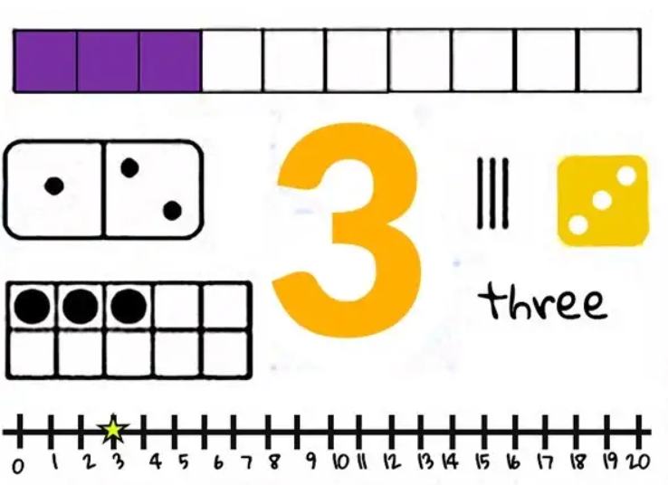
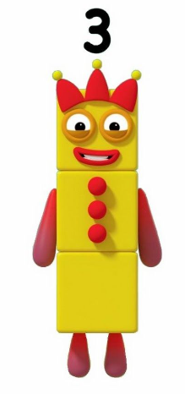
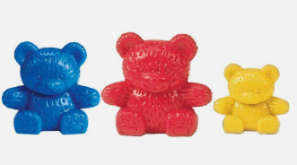
Number sense - Counting, comparing and flexible thinking about number
Notes:
Number sense is not only the ability to count, compare and perform operations on numbers, but also a deep and flexible understanding of numbers, how they relate to each other and how they can be manipulated.
Underpins most other mathematical learning, so it is vital that children develop a strong understanding of numbers in their early years.
Can be improved by encouraging children to make links, reason, giving children opportunities to explore numbers in different ways and move between representations.

Slide 12
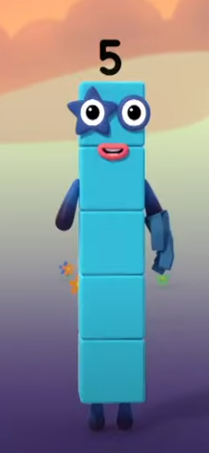
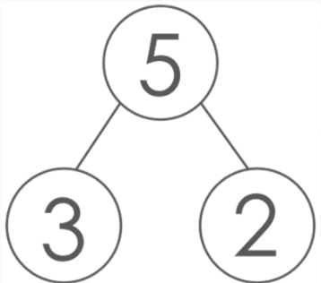
Mastering Number
Notes:
When a child understands the composition of number, they understand that numbers are made up of other numbers. They ‘see the numbers inside’ other numbers: first, that all numbers are made up of ones, and then that they can be made up of pairs of bigger numbers.
So for example, 5 is made of ‘five ones’, or of ‘1 and 4’, or of ‘2 and 3’.
The CBeebies' Numberblocks characters demonstrate this with their ability to split into other characters as shown as shown in The Whole of Me is Five. https://www.youtube.com/watch?v=zLZNSNj5nVg
Understanding composition of number is fundamental to understanding the structure of part-part-whole relationships, which can be represented with a part-part-whole model, as below:
When 5 is partitioned into 3 and 2, then 3 is a part and 2 is a part and 5 is the whole.
The concept of composition allows children to build fluency with number bonds – not only number bonds of 10, but all the number bonds within numbers. So, back to the example of 5: number bonds of 5 are: 0 and 5, 1 and 4, 2 and 3.
Understanding composition also supports an understanding of commutativity: if you have learned that 2+3=5, then you also know that 3+2=5 without having to learn it as a new fact.
Composition is also crucial in starting to understand addition and subtraction and their inverse relationship. For those that understand composition of number, remembering that 2+3=5 and 5-2=3, and how these two facts relate, is less a matter of repetition and memorisation and more the application of structural understanding. When we add, we compose: when we subtract, we decompose.
Within the NCETM/Maths Hubs Mastering Number Programme, sessions are designed to build understanding of the composition of number for children in Reception, Year 1 and Year 2.

Slide 13
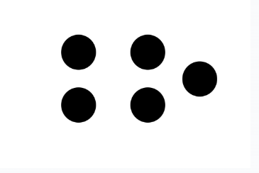
Mastering Number
https://mathsbot.com/manipulatives/rekenrek
Notes:
Different patterns of spots are used, in different arrangements, and children are encouraged to ‘subitise’ (see without counting) the smaller numbers ‘within’ the bigger numbers.
What do you see? Maybe the 4 in a square, and the odd 1?
What do you see if they are coloured like this? Probably the 2 and 3.
Children might be encouraged to say, “I know this is 5, because I can see 3 red dots and 2 black dots.”
Different layouts of coloured dots within the Hungarian number frames below help develop recognition of different configurations of 3 and 2 and therefore 5.

Slide 14
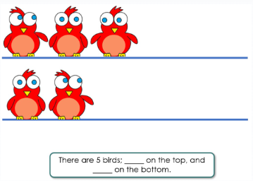
Mastering Number
https://mathsbot.com/manipulatives/rekenrek
Notes:
Moving the birds between the different wires allows children to see that different pairs of numbers make 5.

Slide 15
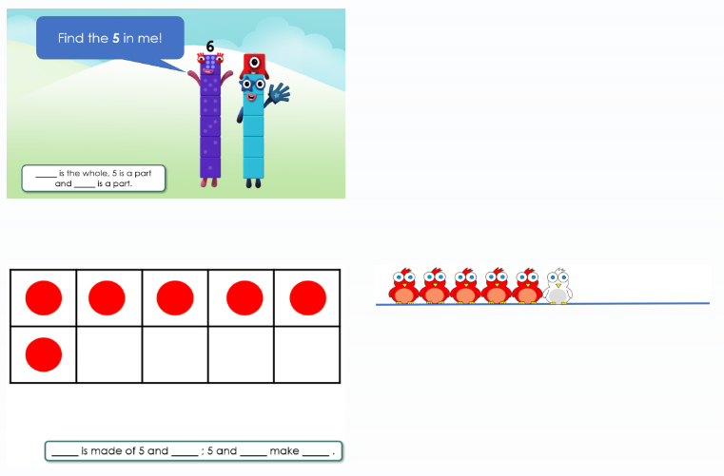
Mastering Number
https://mathsbot.com/manipulatives/rekenrek
Notes:
For numbers between 5 and 10, children are encouraged, again through the representations used, to see the ‘5 and a bit’ structure.
Understanding numbers in relation to both 5 and 10 is important for developing efficient calculation strategies. So seeing the 5 (and a bit) in 6, 7, 8 and 9, is especially helpful.
As well as identifying that 5 is a part of the numbers 6,7,8 and 9, other bonds of these numbers are also explored separately.
Different representations of 6 are used to expose different compositions of 6: ‘5 and a bit’, but also ‘3 and 3’, or ‘2 and 2 and 2’.
Can you put 6 counters on your ten frame and use the red and yellow sides to show different pairs of numbers that make 6? Write them on your whiteboard. Did you write systematically?

Slide 16
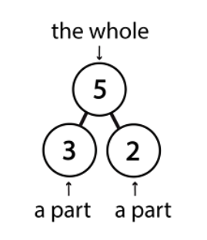
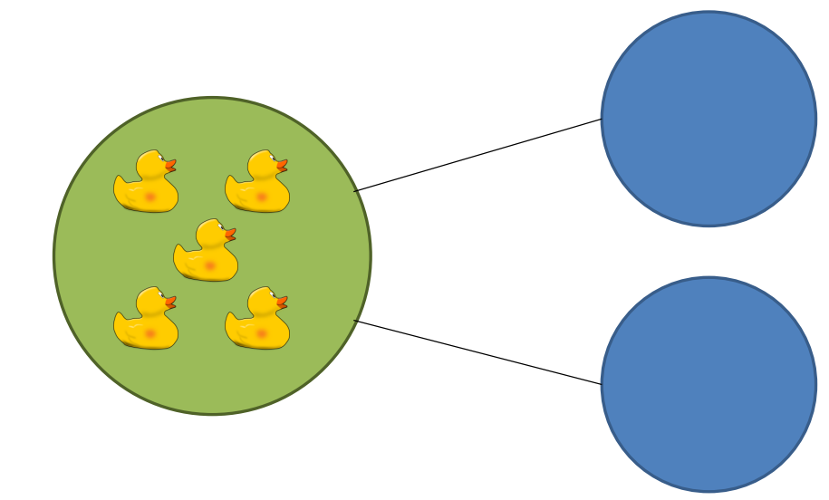
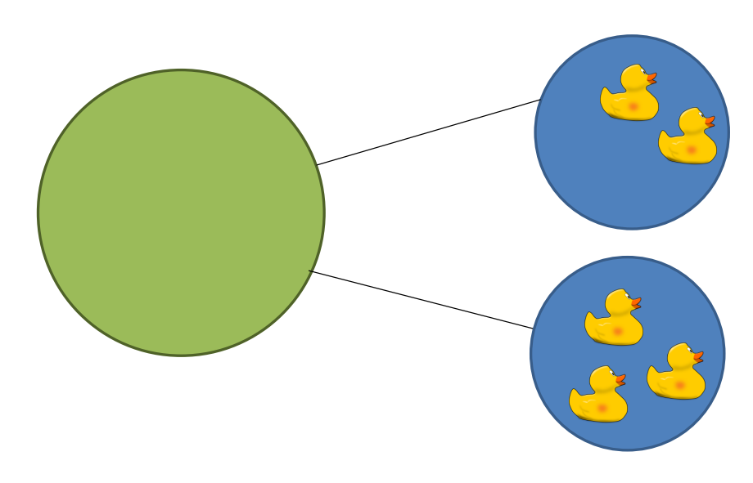
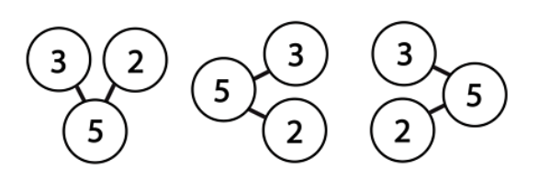
Part whole models

Slide 17
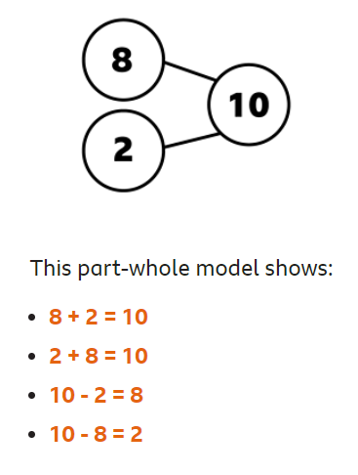
Part whole models
https://www.ictgames.com/mobilePage/partPartWhole/index.html
Take 10 counters or cubes, this is your whole.
On your table can each of you partition (split up) your 10 in different ways?

Slide 18
Place value
Children need to have a concrete understanding of place value in Year 1. It involves understanding what each digit represents. They need to be able to
identify and represent the number using objects and images.
https://www.ictgames.com/mobilePage/arrowCards/
https://www.topmarks.co.uk/place-value/place-value-charts
https://www.topmarks.co.uk/learning-to-count/place-value-basketball
Please note - we no longer use the term units – they’re ones.

Slide 19
Can you make the whole 58 on the place value chart using the base 10?
Base 10

Slide 20
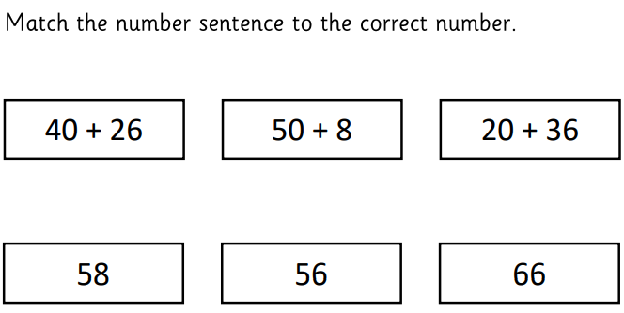
Using place value
In Year 2 children need to develop a true understanding of how numbers change when 10s and 1s are added or taken away. This supports mental calculation skills and fluency.
Talk to the person next to you about different ways you could partition 58 using your part whole model.
https://www.topmarks.co.uk/maths-games/daily10
https://www.topmarks.co.uk/place-value/bead-numbers

Slide 21
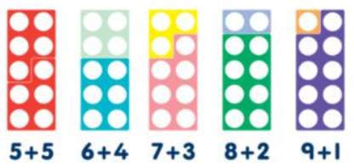
Some resources we use
Numicon also known as number frames
Double sided counters
Arrow cards
Number lines
https://mathsframe.co.uk/en/resources/resource/37/placing_numbers_on_a_number_line
Hundred squares
https://www.topmarks.co.uk/learning-to-count/paint-the-squares
Ten frames
https://www.ictgames.com/mobilePage/tenFrame/index.html
https://www.nctm.org/Classroom-Resources/Illuminations/Interactives/Ten-Frame/
Part whole models
Bar models

Slide 22
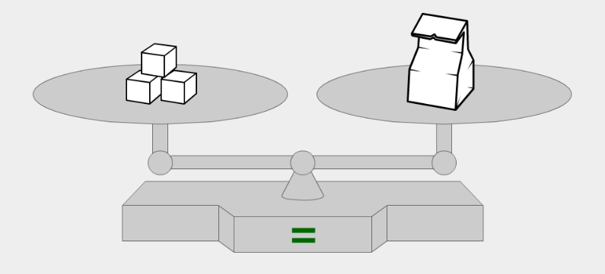
The equals symbol =
We read this as ‘is equal to’ or ‘equals’, meaning ‘having the same value as’.
For example: 7 – 2 = 4 + 1

Slide 23
Patterns
How is the 100 square organised?
What patterns do you notice?

Slide 24
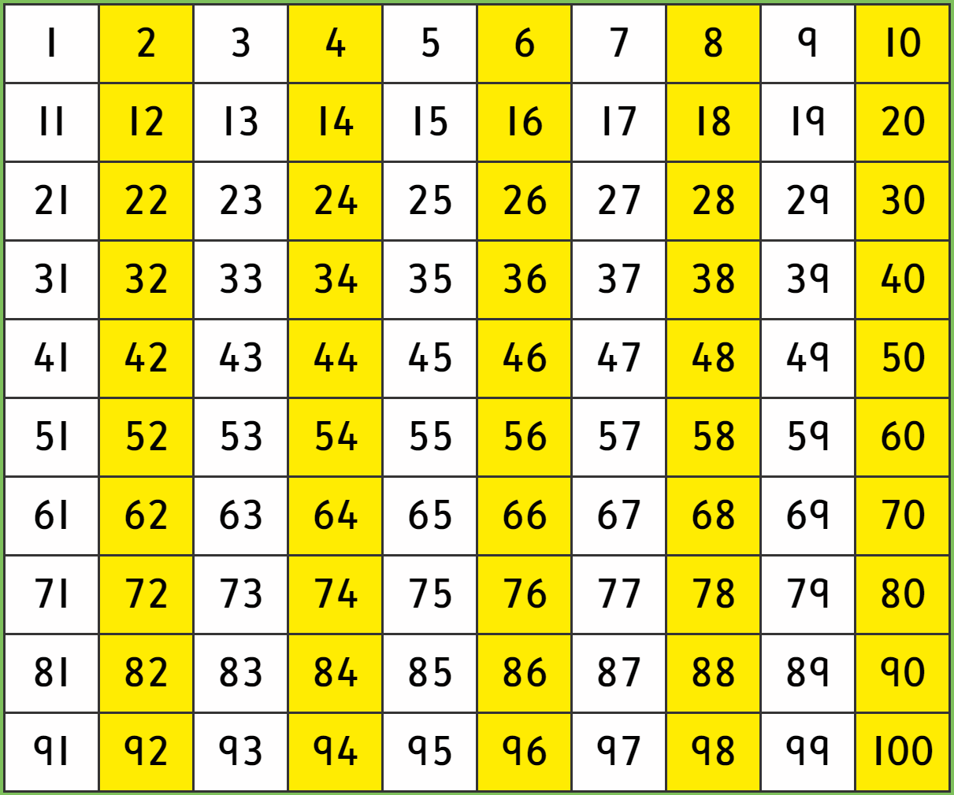
Patterns
Patterns in rows/columns
Odd/even
1 more/less
10 more/less
Multiples of 2, 5, 10.

Slide 25
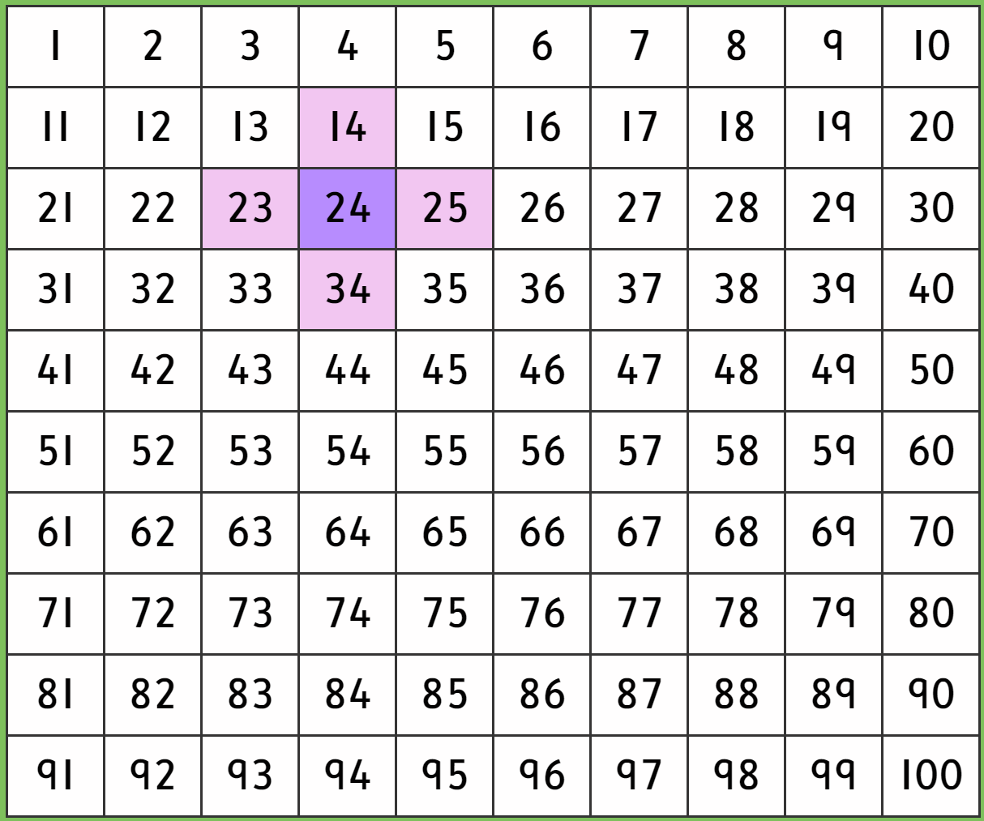
Patterns
Patterns in rows/columns
Odd/even
1 more/less
10 more/less
Multiples of 2, 5, 10.

Slide 26
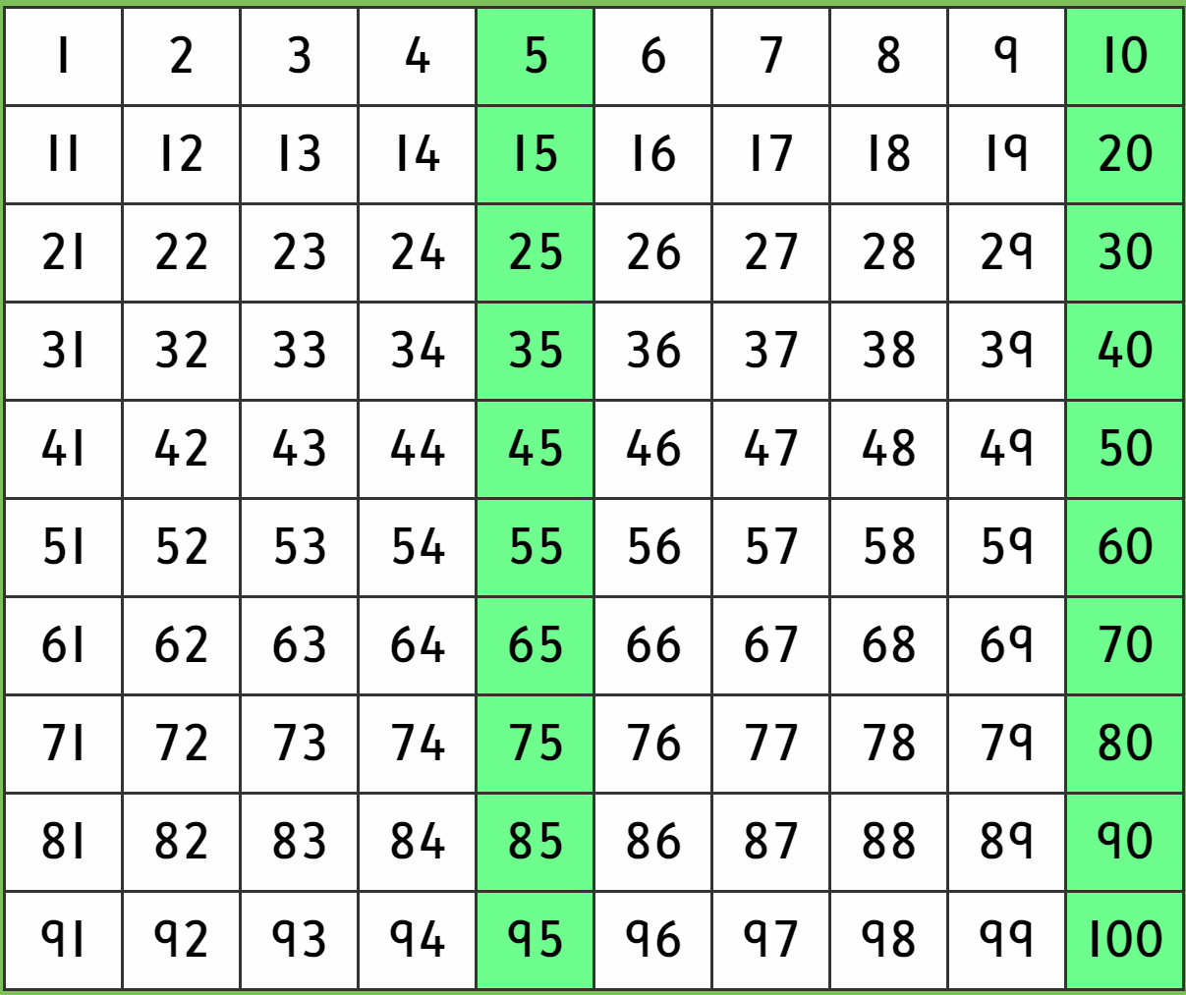
Patterns
Patterns in rows/columns
Odd/even
1 more/less
10 more/less
Multiples of 2, 5, 10.

Slide 27
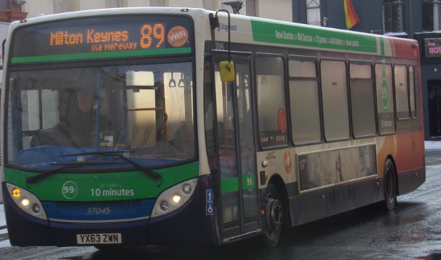
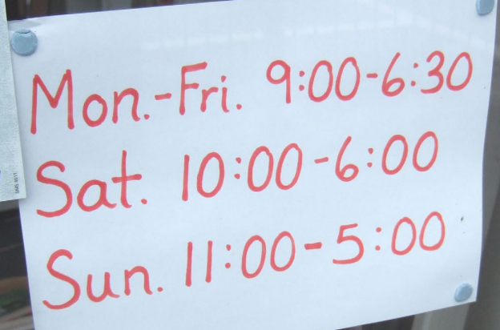
How to help at home
Numbers everywhere!
Counting
Songs, board games, steps. When doing craft, shopping, cooking. Forwards, backwards, in 2s, 5s, 10s. Socks, fingers. Money is great for this too.
Can they start from any number? Can they say 1 more/less, 10 more/less? Can they estimate how many?
Number facts
Bonds of numbers to 20 – all the ways to
make that number.
Related facts – addition & subtraction
If I know 3 + 4 = 7 then what else do I know?
4 + 3 = 7
7 – 4 = 3
7 – 3 = 4
30 + 40 = 70
14 + 3 = 17
13 + 4 = 17
17 – 4 = 13
17 – 3 = 4

Slide 28
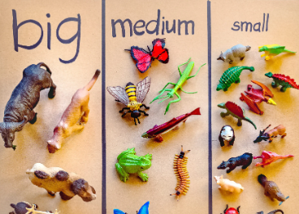
How to help at home
Sorting
By how many, by colour, by shape, by size, by pattern.
e.g. socks, beads, plates/bowls, cutlery, anything children
are interested in!

Slide 29
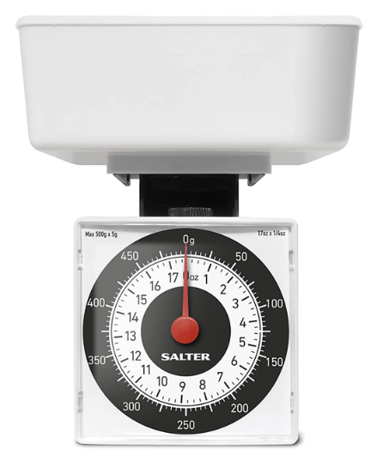
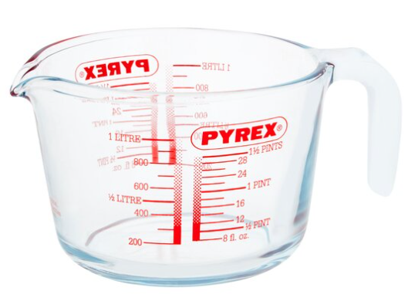
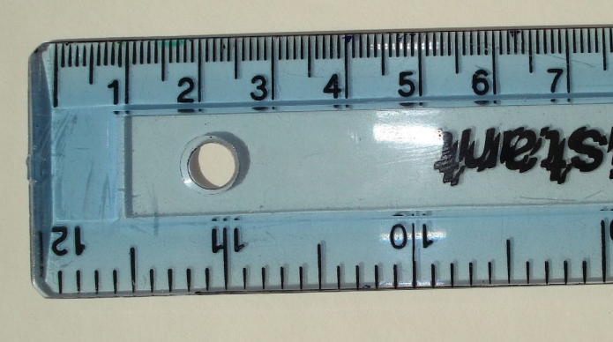
How to help at home
Measuring
Length, width, height, weight, capacity temperature and time.
More about time
Names of days, months. Compare and sequence intervals of time. Number of seconds, minutes, hours, days, months.

Slide 30
How to help at home
Shapes
Go for a shape walk/hunt, look for shapes at home.
Talk about their names, their properties – faces, edges, vertices.
2d and 3d in our environment.

Slide 31
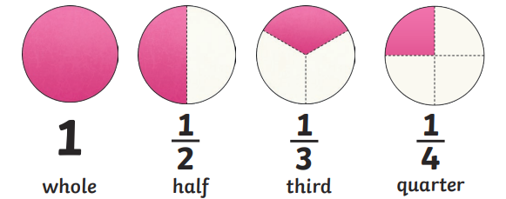
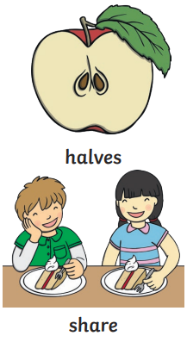
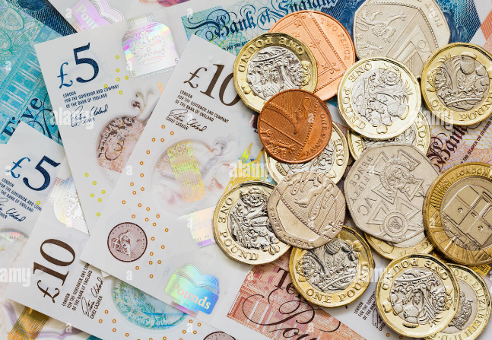
How to help at home
Fractions
When sharing things out, cutting things up, crafting, cooking.
Fractions of shapes, lengths, amounts, objects.
Money
Role play with real money.
Recognising coins and notes.
Making the same amount in different ways.
Working out change.

Slide 32
Any questions?
Find out what children learn in Maths in Foundation Stage and Key Stage 1
Discuss how we teach Maths and why
Look at some resources and models we use
Support you with ideas to help at home
Thank you for coming

